Slide 1
Tuesday, October 16, 2012
No TISK or Mental Math problems this week.
Homework:
p. 199-200 #9, 10, 12, 24, 27-29all, 30-34even

Slide 2




4-1 & 4-2 Worksheet Check
1-6 are sample answers:
1) 2)
3) 4)
5) 6)
7) $\overline{AB},\overline{BC},\overline{AC}$
8) $∠A, ∠B, \& ∠ACB$
9) $∠ACB$
10) $∠A \& ∠B$
11) $\overline{AB}$
12) $\overline{BC} \& \overline{AC}$
13) $∠B$
110$°$
120$°$
70$°$

Slide 3
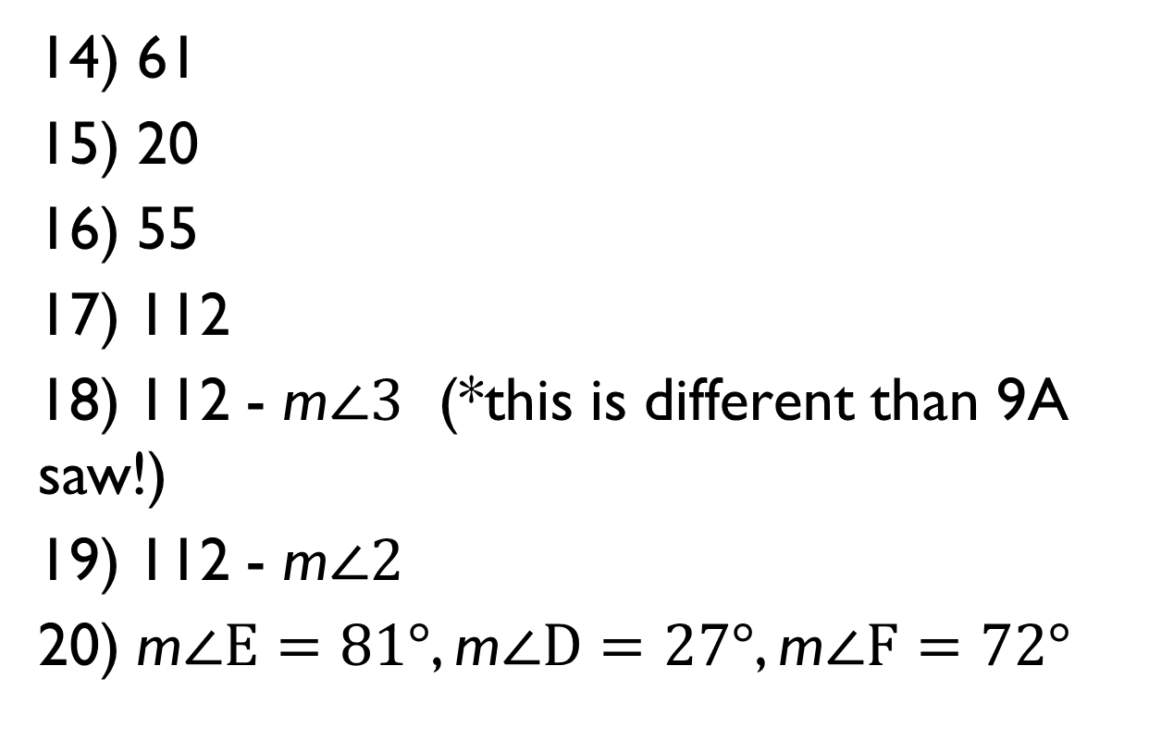
4-1 & 4-2 Worksheet Check
14) 61
15) 20
16) 55
17) 112
18) 112 - m$∠3$ (*this is different than 9A saw!)
19) 112 - m$∠2$
20) m$∠E=81°$, m$∠D=27°$, m$∠F=72°$

Slide 4
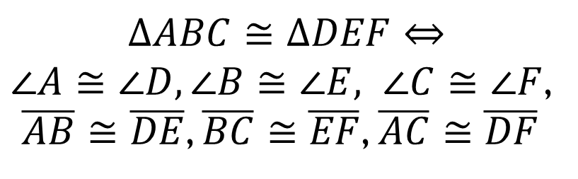
§4-3 Exploring Congruent Triangles
Congruent means “having the same shape and size”.
So what would it take for two triangles to be congruent?
  All the angles are congruent.
  All the sides are congruent.
$$∆ABC≅∆DEF⇔$$
$∠A≅∠D,∠B≅$ $∠E, ∠C≅$ $∠F$,
$\overline{AB}≅$ $\overline{DE}$, $\overline{BC}≅$ $\overline{EF}$, $\overline{AC}≅$ $\overline{DF}$
B
E
D
A
C
F

Slide 5
§4-3 Exploring Congruent Triangles
Theorem:
(CPCTC – Corresponding Parts of Congruent Triangles are Congruent)
Two triangles are congruent if and only if their corresponding parts are congruent.

Slide 6












§4-3 Exploring Congruent Triangles
Given: $\overline{TU}⊥\overline{RS}$, $∠R≅∠S$, $\overline{UR}≅\overline{US}, \overline{TR}≅\overline{TS}$
Prove: $∆TUR≅∆TUS$
T
R
U
S
Plan for Proof: Show all three pairs of angles and all three pairs of sides are congruent
If $⊥⇒4 rt ∠$s
$$∠R≅∠S$$
(G)
$$\overline{UR}≅\overline{US}$$
(G)
$$⊥$$
4 rt. $∠$s
$$∠TUR≅∠TUS$$
$$\overline{TR}≅\overline{TS}$$
(G)
(G)
Rt. $∠$s are $≅$
3rd $∠$s Th.
$$\overline{TU}≅\overline{TU}$$
$$∠RTU≅∠STU$$
(Reflexive)

Slide 7
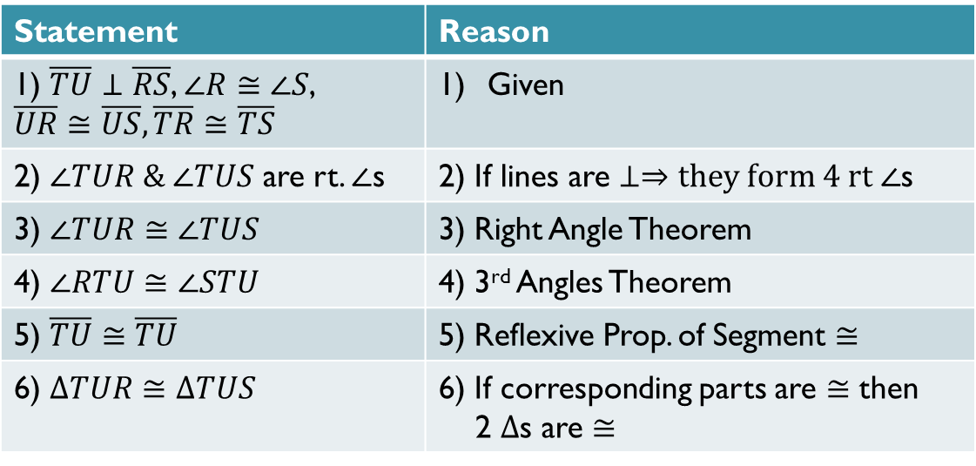
§4-3 Exploring Congruent Triangles
T
Given: $\overline{TU}⊥\overline{RS}$, $∠R≅∠S$, $\overline{UR}≅\overline{US}, \overline{TR}≅\overline{TS}$
Prove: $∆TUR≅∆TUS$
R
S
U
Statement | Reason
1) $\overline{TU}⊥\overline{RS}$, $∠R≅∠S$, $\overline{UR}≅\overline{US}, \overline{TR}≅\overline{TS}$ | Given
2) $∠TUR \& ∠TUS$ are rt. $∠$s | 2) If lines are $⊥⇒they form 4 rt ∠$s
3) $∠TUR≅∠TUS$ | 3) Right Angle Theorem
4) $∠RTU≅∠STU$ | 4) 3rd Angles Theorem
5) $\overline{TU}≅\overline{TU}$ | 5) Reflexive Prop. of Segment $≅$
6) $∆TUR≅∆TUS$ | 6) If corresponding parts are $≅$ then 2 $∆$s are $≅$

Slide 8
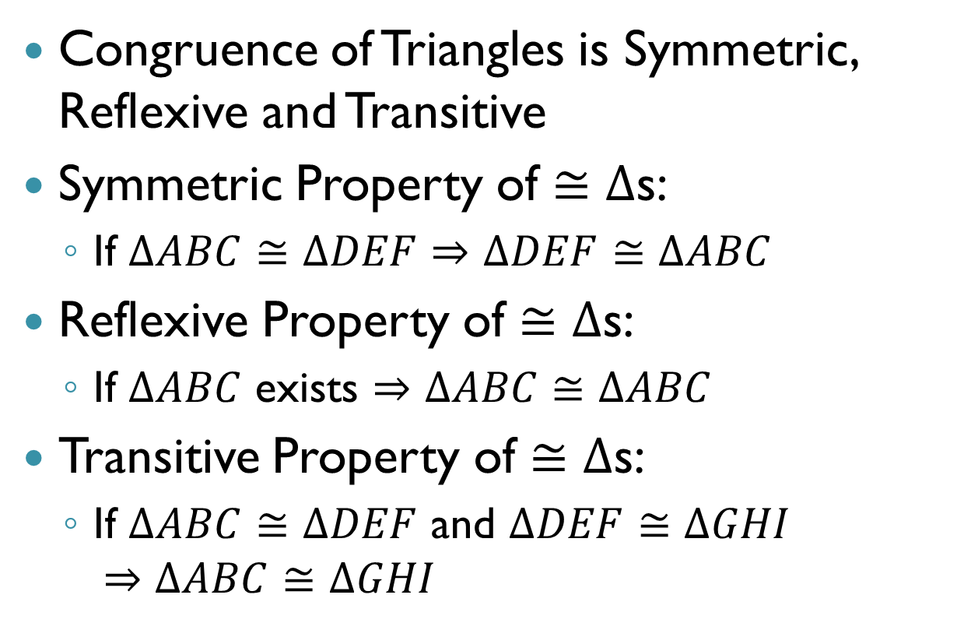
§4-3 Exploring Congruent Triangles
Congruence of Triangles is Symmetric, Reflexive and Transitive
Symmetric Property of $≅∆$s:
  If $∆ABC≅∆DEF⇒∆DEF≅∆ABC$
Reflexive Property of $≅∆$s:
  If $∆ABC$ exists $⇒∆ABC≅∆ABC$
Transitive Property of $≅∆$s:
  If $∆ABC≅∆DEF$ and $∆DEF≅∆GHI$
  $⇒∆ABC≅∆GHI$

Slide 9

Homework
p. 199-200
#9, 10, 12, 24, 27-29all, 30-34even

